Slide 1
Pegasys 101 Training

Slide 2
Outline
Overview
Standard Workflow
Doc Types
Basic Navigation
Features
Transactions
Pegasys Security
Notes:
-This is an overview class, we will touch over things briefly and teach you how to navigate through Pegasys
- Purchase Request, Orders, Receipts, and Credit Card are all separate classes

Slide 3
What is Pegasys? Pegasys Overview
Pegasys is GSA’s web-based integrated financial management system.
Pegasys offers extensive functionality to record financial planning and purchasing events as well as accounts payable, disbursement, and budgeting activities.
Notes:
Everything used to be on paper and was a mess, had to send paper copy to Finance Centers

Slide 4
Standard Workflow
Standard Workflow is the automated process that is used for corrections, approvals, and ad-hoc routing
Forms and documents appear in the Inbox with a task name and description that describes the action required
Notes:
Example: PR needs 3 approvals
1. Purchasing Manager
2. Accounting Classification
3. Funds Authorization
You add in people’s names with their approval rights
Pegasys sends it to the right Inbox
Can have backups

Slide 5
Standard Workflow
Correct Forms
Forms requiring corrections are automatically routed to the Inbox of the user who submitted the form
Approvals
Forms requiring approvals are automatically routed to the Inbox of designated approvers
Ad-Hoc Routing
Manually routed forms and documents appear in the Inbox of the recipient
Notes:
Correct Forms: It may say that it has been “Submitted Successfully” and you could get it back to your Inbox if you’re approval routing is wrong

Slide 6
Standard Workflow
When submitting a form for processing, the following system logic occurs:
Check for hard or non-overridden errors
Check for applicable approvals
Determine order of approval types if multiple
Send Approve Form task to Inbox of appropriate approvers
After the final approval is applied, the form automatically processes

Slide 7
Standard Workflow
Users add the form’s approvers on the Approval Routing page
Upon submission, Pegasys will automatically route the form to the selected approvers
With multiple approvals, approvals are applied in a specific order
Users will not need to add approvers to the form in any specific order; Pegasys will automatically route the forms for approval in the correct order

Slide 8
Standard Purchasing Model Pegasys
Invoice
M7/M6
Request
PR
Order
GP
Payment
Authorization
P7/P6
Receipt
RW/RK

Slide 9
Standard Purchasing Model
Invoice
Request
Order
Payment
Authorization
REQUEST
Optional step in purchasing chain.
Records intent to buy goods/service but not legally binding.
Commits funds, decreases available budget and plan amounts (obligation-based budget only).
Must be approved before it can be processed.
Entered into Pegasys by a Requisitioner.

Slide 10
Standard Purchasing Model
Invoice
Request
Order
Payment
Authorization
ORDER
Obligates funds.
Legal contract with vendor.
Decreases available budget and plan amounts (obligation-based budget only).
Must be approved before it can be processed.
Entered into Pegasys by an Authorized Buyer, or Contracting Officer.

Slide 11
Standard Purchasing Model
Invoice
Request
Order
Payment
Authorization
Receipt
Receipt
RECEIPT
Records an accrued expenditure (estimated or actual accrual).
Records delivery/acceptance of goods and services.
May adjust available budget and plan amounts.
E-mail notification sent if receipt is not logged at the time the invoice is logged.
Entered into Pegasys by a Receiver.

Slide 12
Standard Purchasing Model
Invoice
Request
Order
Payment
Authorization
INVOICE
Records receipt of vendor invoice.
Records invoice status information.
Will not decrease available budget or plan amounts (except for Direct Pays).
Initiates payment through automated match process.
Entered into Pegasys by Finance.

Slide 13
Standard Purchasing Model
Invoice
Request
Order
Payment
Authorization
Payment
Authorization
Receipt
PAYMENT
Final step of the purchasing chain.
Automatically generated when successful match occurs.
Schedules payments for disbursement according to prompt pay regulations, vendor payment terms, and available discounts.
Establishes and releases contract holdbacks.

Slide 14
Doc Types – Orders
P = PBS
Q = FAS
F = FSS
T = FTS
G = GM&A
O = Other
X = Client
Training Order*
__W (Training Order)
__Y (Prepaid Training Order)
Purchase Orders*
__P (Non-Itemized PO)
__X (Non-Itemized Inter-agency Order)
GM&A to another Federal Agency
*First position denotes Service

Slide 15
Doc Types – Orders
D6 - Direct Pay Region 6, Under $3,000
D7 – Direct Pay Region 7, Under $ 3,000
CL – Credit Card Log
CT – Credit Card Training Log
PJ – PBS 3-Way Obligation
PN – PBS Construction Obligation
IX – Non-Itemized Intra-agency Order
Within GSA from one service to another
Notes:
Comprizon awards obligation and we use PJ and PN’s to record it in Pegasys (can’t print them)
IX- Example: GM&A and PBS have a transaction between themselves

Slide 16
Doc Types
PR - Purchase Request
TR – Training Request
RK – Receipt6 Region 6 - Kansas City
RW- Receipt7 Region 7 – Fort Worth
M6 - Match Invoice 3-Way R6
M7 - Match Invoice 3-Way R7
P6 - Payment Authorization - Reg 6 Prompt Pay
P7 - Payment Authorization - Reg 7 Prompt Pay
Notes:
PR is the first step- form 49
RW- PBS
RK- everything else

Slide 17
Doc Types – DC Courts
CO – DCC Purchaser Order
CF – DC Courts Fixed Order
CY – DC Courts Travel/Training Obligation
CD – DC Courts Direct Pay Invoice
CN – DC Courts Direct Pay Not Subject to PP
MC – DC Courts 3-Way Invoice
MT – DC Courts 2-Way Invoice
Notes:
Skip slide if nobody in the class is from DC courts

Slide 18
Getting Started Gaining Access to Pegasys
Access is based on associate’s role in GSA
Fill out Pegasys Access Form and submit to Supervisor
http://www.pegasys.gsa.gov/
Supervisor approves form and submits it to the Service Level or Region Functional Coordinator
Client Services emails associate a User Name and a One-Time-Use Password
Notes:
Fill out form, have supervisor sign it, hand it in to your functional coordinator (available under Help tab of Pegasys homepage)

Slide 19
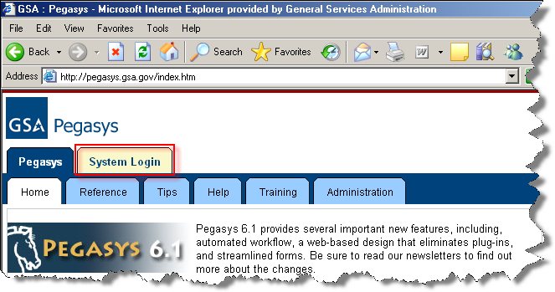
Getting Started Logging In
Go to: http://pegasys.gsa.gov/
Click the ‘System Login’ Tab

Slide 20
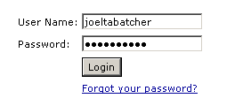
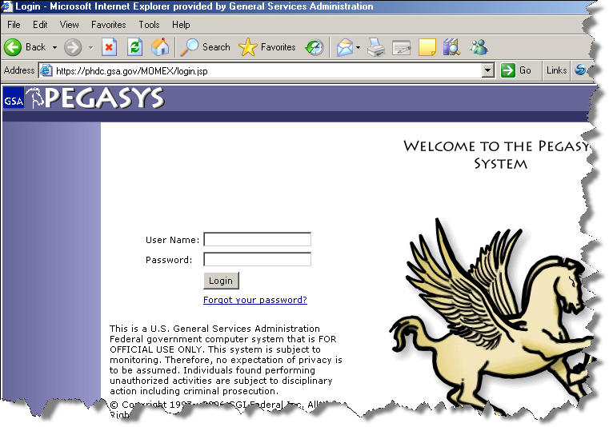
Getting Started Logging In
User Name: FirstNameLastName (lowercase, no spaces)
Password: Use One-Time-Use Password, then change password promptly upon entering the system
Notes:
MUST change password first time!
Password then lasts for 90 days

Slide 21
Purchasing Module
Automated Match functionality can generate payments immediately after an automated match purchasing chain is processed and supports three basic matching models
* One Way
* Two Way
Automated Match three-way example
* Three Way
Receipt
Request
Order
System
Generated
Payment
Invoice
Notes:
Two-Way Match – Are used in Prepayments (training and subscriptions)
One-Way Match - $3,000 simple purchase (no fees)…This has 3 approvals and the payment goes out in that period.
We use this to pay for a KC associate’s rent in DC.

Slide 22
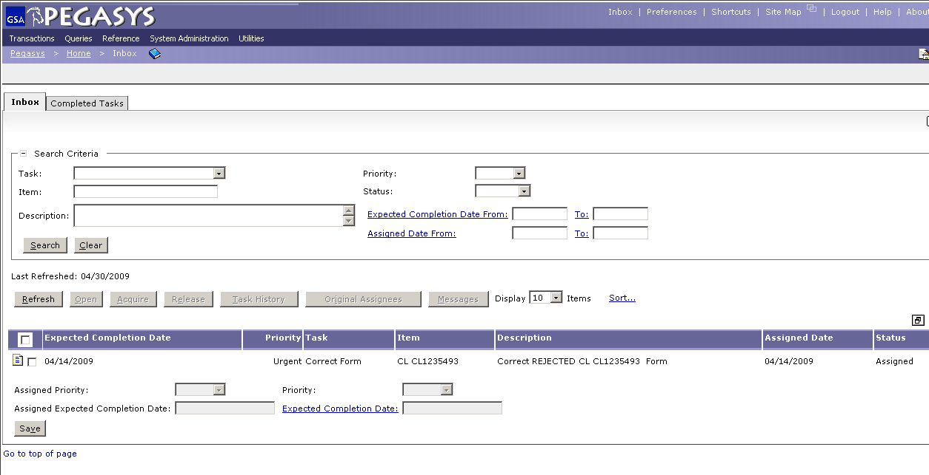
Basic Navigation
Link Strip
Menu Bar
Breadcrumbs Track
Inbox
Notes:
This is where you see documents that you need to approve
If your document was rejected it will come back to here

Slide 23
Basic Navigation - Link Strip
Located at the top right portion of the screen
Includes these links:
Inbox - Allows access to the Inbox
Preferences - Allows users to customize their screens
Shortcuts - Used for direct access to forms and documents
Site Map - Alternative way to navigate within Pegasys
New Window icon - Allows users to open a new window in the same Pegasys session
Logout - Ends current session
Help - Online Baseline Momentum documentation
About – Displays the current version of Pegasys
Notes:
Preferences-where you change your password
New Window- if you try to X out the window instead of hitting “Close Window” a warning should pop up
Help- review user guides to get pegasys specific guides
Shortcut- can create a document and make a shortcut to it but searching in Form/Doc select is better so we don’t use Shortcut

Slide 24
Basic Navigation - Menu Bar
Located underneath the Pegasys image
Includes new items:
Transactions
Provides access to transactions to each subsystem
Includes Form/Document Selection query
Queries
All queries are now grouped under this menu option
System Administration
No longer a separate Pegasys application
Need security permissions to view and utilize
Utilities
Users can create reports under this menu option
Notes:
Transactions- Create/correct/amend documents or forms
Utilities- where you go to get reports
Bookmarks- cannot bookmark a page using web browser bookmark

Slide 25
Basic Navigation - Inbox
The Inbox is the homepage for Pegasys
Any documents needing Approval will appear
Any documents that you submitted that were rejected will appear

Slide 26
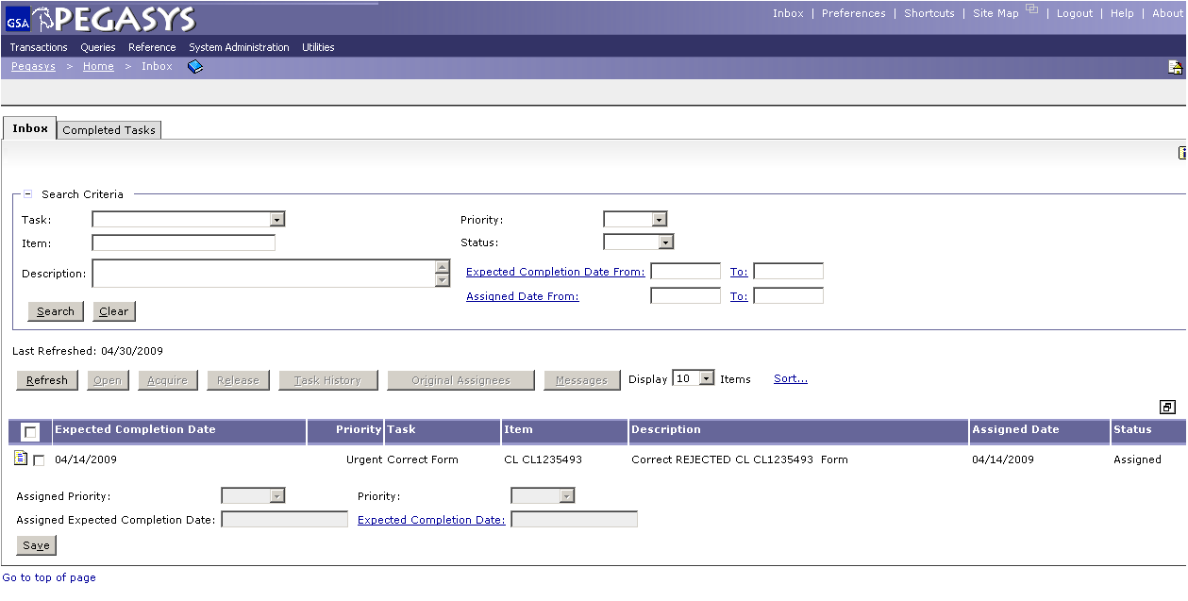
Basic Navigation - Inbox

Slide 27
Basic Navigation - Breadcrumbs Track
Breadcrumbs track the user’s path as he/she navigates through Pegasys
Breadcrumbs provide a path that links users back to previous locations accessed in Pegasys
Each breadcrumb is a link
Use Breadcrumbs in lieu of the web browser ‘Back’ button
Notes:
Allows to back track in Pegasys b/c clicking the back button in the web browser causes an error
Like Hanzel and Grettle

Slide 28
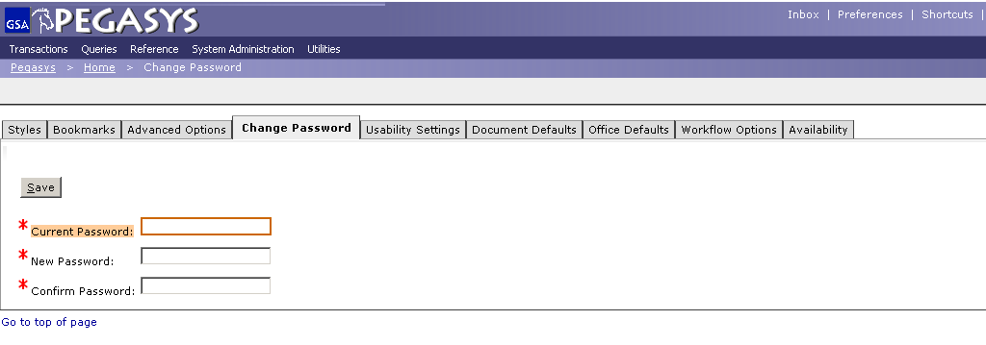
Basic Navigation - Preferences
Change Password
Document Defaults
Office Defaults
Password lasts for 90 days
Notes:
Styles- you can change the color
Change Password: do after first log in
Document Defaults: Example- you do PR’s in your office and only use one Acc Template set up default so everytime you do a PR the Acc Temp will be filled in
Office Default- In PR’s and PO’s have address tabs that you can set defaults for your office

Slide 29
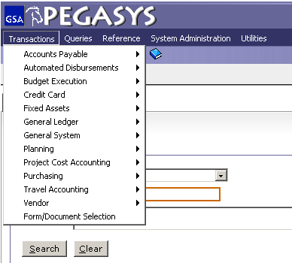
Basic Navigation – Transactions
Credit Cards
Purchasing
Form/Document Select
Notes:
Credit Card- reconciliations
Purchasing- PR’s, PO’s, Receipts, Credit Card
Form/Document- Example: search all GP’s for Larry Sampson from October-November

Slide 30
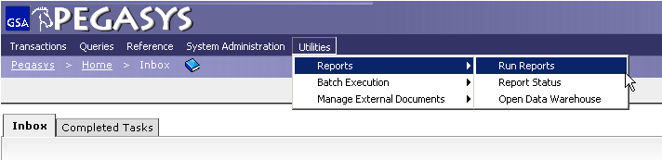
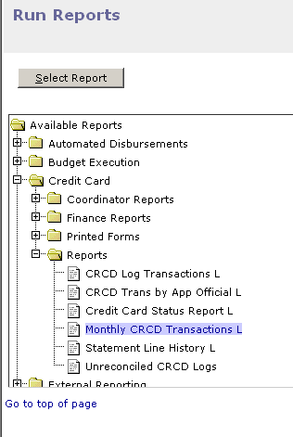
Basic Navigation – Reports
Select:
Utilities
Reports
Run Reports
Highlight the Report
Click Select Report

Slide 31
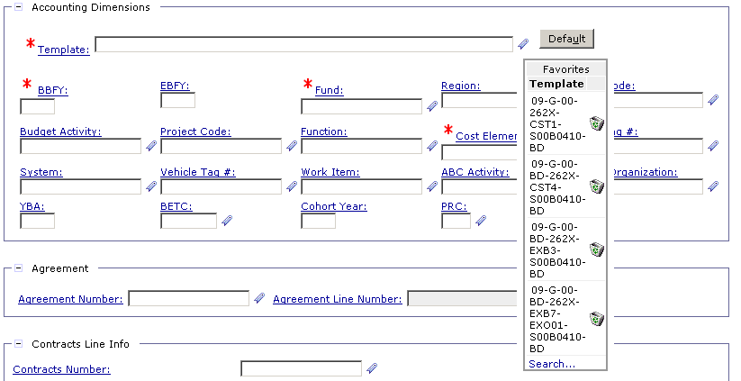
Features - Favorites
Used to expedite the process of creating forms
Values available from the Favorites icon in the appropriate data entry fields in Pegasys
Use the Favorites icon to select frequently used reference data
The * is a wild card for searching
Notes:
You use 310, 320, 330 all the time so add them to your favorites

Slide 32
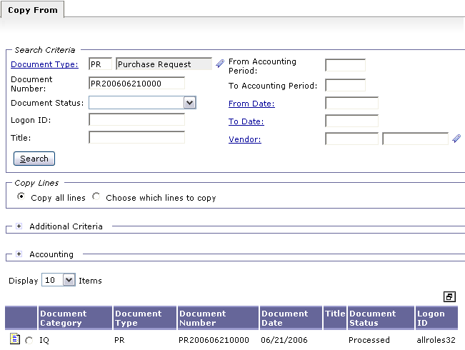
Features - Copy From
The Copy From function is used when the user wants to use an existing form to create the same type of form.
Notes:
Example: BlackBerry bill- you do one for October and just copy from that for November

Slide 33
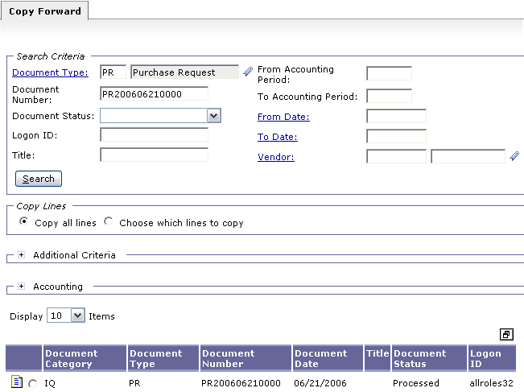
Features - Copy Forward
The Copy Forward function reduces data entry when creating new purchasing forms and ensures that vital information is maintained from one transaction to the next in the purchasing chain .
Notes:
Moving Forward through the purchasing chain

Slide 34
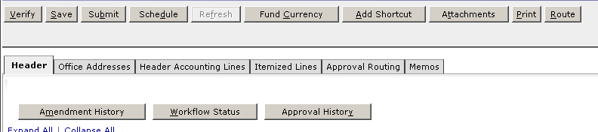
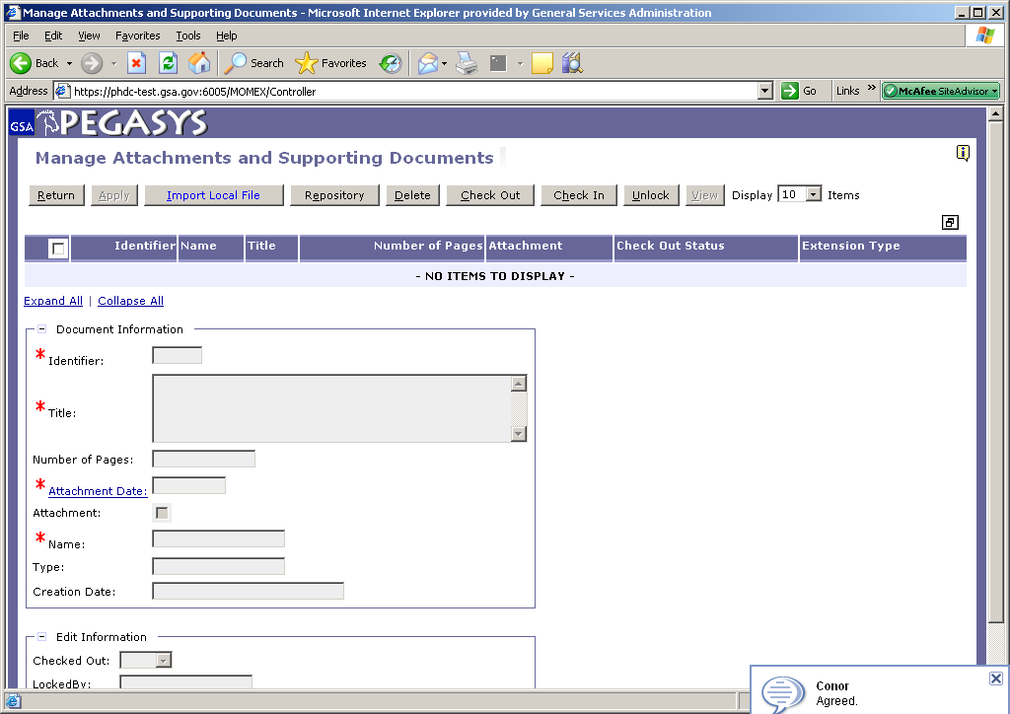
Features - Attachments
Choose Attachments
Click Import Local File

Slide 35
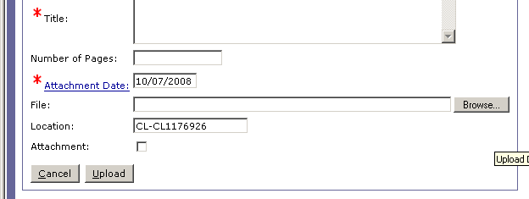
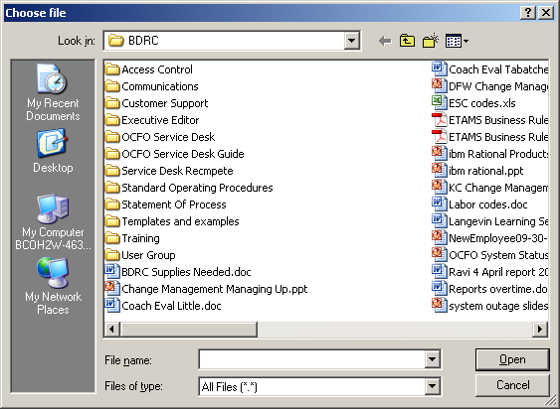
Features - Attachments
Choose:
- Browse
- Your document
- Upload

Slide 36
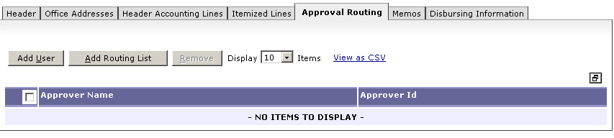
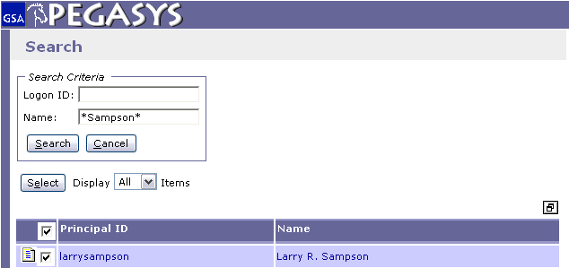
Features - Approval Routing
Select Add User or Add Routing List
The * is a wild card for searching

Slide 37
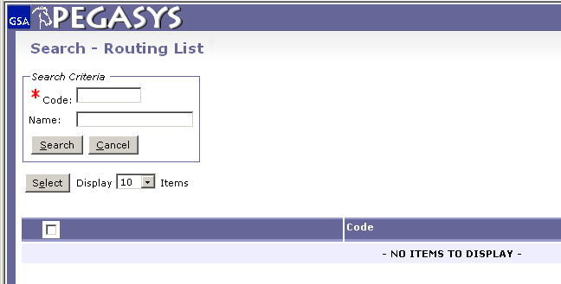
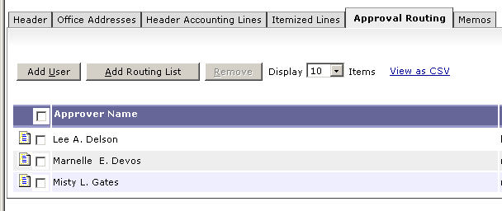
Features - Approval Routing List
Search and Select a routing list

Slide 38
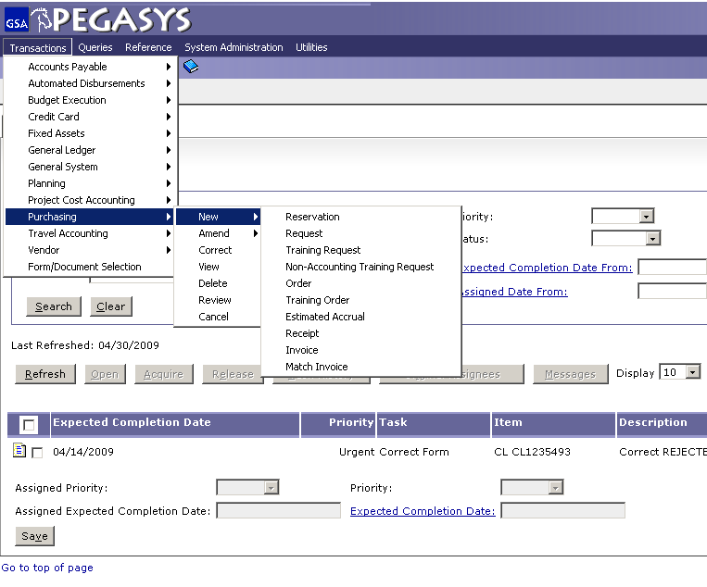

Creating Pegasys Forms & Documents
Reservation
Request
Training Request
Non-Accounting Training Request
Order
Training Order
Estimated Accrual
Receipt
Invoice
Match Invoice
Notes:
Training Request= TR
Not used very often, usually only for Prepaid Training

Slide 39
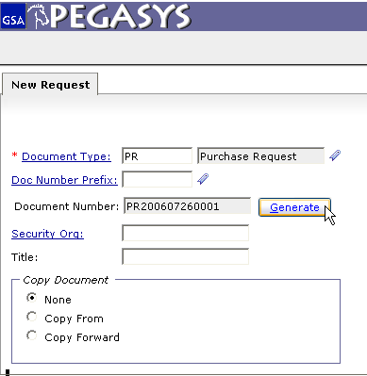
Creating Purchase Requests
Must click the Generate button to obtain Document Number
Notes:
Document Number: The year, month, day and a sequence number

Slide 40
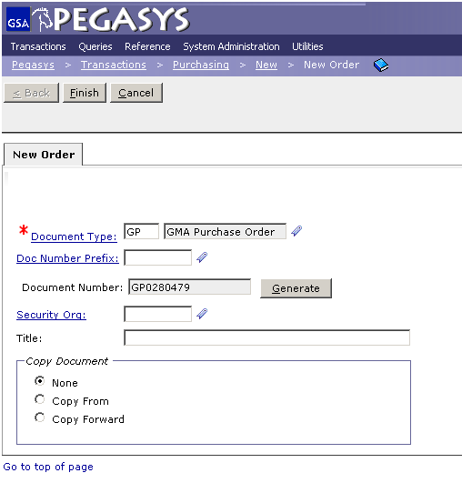
Purchase Order- Document Types
Doc Type
QP, TP, FP = FAS
GP = GM&A
PP = PBS
XP = Client
OP = Other
CO = DC Courts

Slide 41
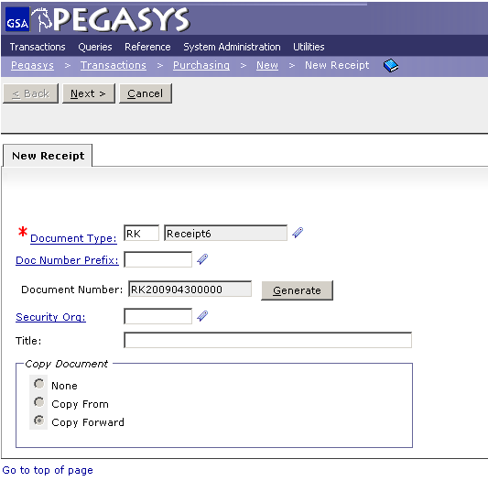
Creating Receipts
Doc Types
RK – Kansas City
RW – Fort Worth
Notes:
Larry’s Soapbox: you DO NOT have to wait until Pegasys prompts you to do Receipt
If you ordered 5 chairs and you are sitting in them and everything is OK then do the Receipt!

Slide 42
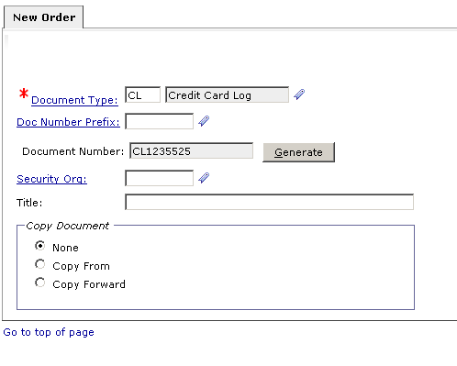
Credit Card Document Types
Doc Types
CL – Credit Card Log
Notes:
Credit Card Document Types

Slide 43
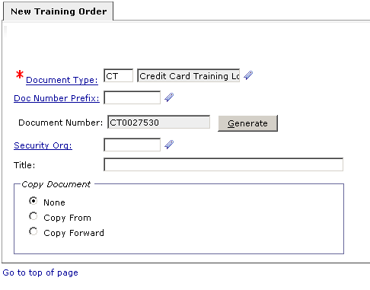
Credit Card Document Types
Doc Types
CT – Credit Card Training Log

Slide 44
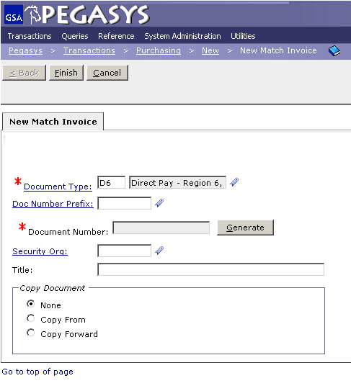
Direct Pay
Enter Document Type, D6 or D7
Click Document Number Field then select Generate
Click Finish in the upper right hand corner
Notes:
Put Doc number on invoice and the email you were sent telling you to order the goods

Slide 45

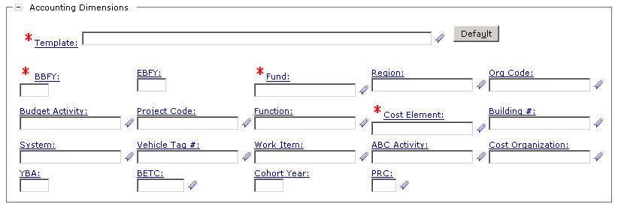
Purchase Requests - Accounting Template
1.
2.
3.
4.
Accounting Templates
Populate the accounting strip with predefined values in order to facilitate accurate data entry.
All purchasing transactions require an accounting template.
Notes:
Header: Fill in Title (optional but higly recommended for when you go back to search later and you have 30 documents)
Different Templates will cause different fields to be mandatory

Slide 46
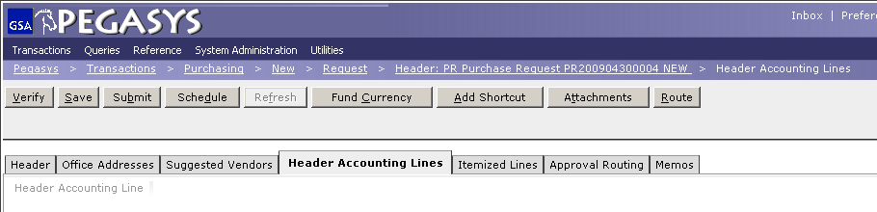
Save, Verify, Submit
Save
Work should be saved often
Verify
Edits form without submitting the form for processing
Spending Edits, Validity Edits, Relationship Edits
It is strongly recommended that forms are verified successfully prior to submitting them for processing or approvals
Submit
Sends the form to Standard Workflow for approval or submits the form for processing

Slide 47
Credit Card Module
Allows users to enter data for purchases of goods and services made with a Credit Card.
A Credit Card purchase enables immediate delivery of goods, but there is a purchase limit.
Citibank is GSA’s credit card provider.

Slide 48
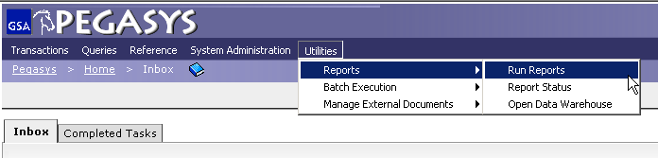
Credit Card Reports
CRCD Log Transactions
Monthly CRCD Transactions
Unreconciled CRCD Logs
Notes:
When you sign up for a Credit Card you say that you will keep a record: Pegasys does it for you, you don’t need to do one on your own

Slide 49
Additional Assistance
Pegasys Web Site - http://pegasys.gsa.gov
Purchasing User’s Guide
Quick Reference Cards
Pegasys Training Classes
OCFO Consolidated Service Desk
1-866-740-0994
Support@gsaservicedesk.com
Notes:
Support Materials

Slide 50
Goals of Information Security
Goals of Information Security
Confidentiality
Data must be protected against unauthorized disclosure
Integrity
Systems must not permit processes or data to be changed without authorization
Availability
Systems must be functional and operational
Confidentiality
Availability
Integrity

Slide 51
Why is Information Security Important?
Must be in compliance with regulatory requirements such as OMB Circular A-130, Computer Security Act, FISMA and GSA IT security policies
Protects GSA information resources from potential abuse and misuse
Follows sounds business practices

Slide 52
User Responsibility
Responsible for adherence to GSA information security policy
Protect Pegasys login ID and password
Do not allow others to use your login ID / password
Do not write it down
Log out whenever you are not using Pegasys
Protect sensitive information
Shred reports containing sensitive information
Report security incidents
Refer to OCFO Incident Handling Procedures for further guidance
Report security incidents to your supervisor

Slide 53
Keys to Incident Prevention
Keys to Incident Prevention
Awareness - be aware of the value of the assets you are using to do your job and the nature of associated threats vulnerabilities and suspicious activities
Compliance - comply with established safeguards, policies, and processes
Common Sense - if something appears to be off, it generally is

Slide 54
Remember ...
Security is a PEOPLE issue,
not only a TECHNICAL one!

